Slide 1
CLASS-IX SUBJECT: MATHEMATICS TOPIC : LINEAR EQUATION IN TWO VARIABLE

Slide 2
CONTENTS
INTRODUCTION
LINEAR EQUATIONS
SOLUTION OF A LINEAR EQUATION
GRAPH OF A LINEAR EQUATION IN ONE VARIABLE
GRAPH OF A LINEAR EQUATION IN TWO VARIABLES
EQUATIONS OF LINES PARALLEL TO X-AXIS AND Y-AXIS
EXAMPLES AND SOLUTIONS
SUMMARY

Slide 3
LEARNING OBJECTIVES
Students will know/recall the definition of the Linear equation in Two Variables.
They will understand the correct form of writing the Linear Equations in Two Variables
They will be able to represent the Linear equations in one variable and two variables geometrically.
They will be able to find the solution of the equation from the graph.
They will be able to connect the real life problems to Linear equations and solve.

Slide 4
Introduction
EQUATION :A statement of equality involving one or more than one variable.
LINEAR EQUATION : Equation in which highest power of variable is 1.
VARIABLE : Unknown quantity(s) involved in an equation.

Slide 5
LINEAR EQUATION IN ONE VARIABLE
When an equation has only one variable of degree one, then that equation is known as linear equation in one variable.
Standard form: ax+b=0, where a and b ϵ R & a≠0
Examples of linear equation in one variable are :
3x-9 = 0 2t = 5

Slide 6
LINEAR EQUATION IN TWO VARIABLES
When an equation has two variables both of degree one, then that equation is known as linear equation in two variables.
Standard form: ax+by+c=0, where a, b, c ϵR& a,b≠0
Here ‘a’ is called coefficient of x, ‘b’ is called coefficient of y and c is called constant term.
Examples of linear equations in two variables are: – 7x+y-8 = 0 – 6p-4q+12 = 0

Slide 7
Properties of an equation:
a) Same quantity can be added to both sides of an equation without changing the equality.
Ex:x-10=0 $⟹$ x-10+10=10 $⟹$x=10.
b) Same quantity can be subtracted from both sides of an equation without changing the equality.
Ex: x+5=0 $⟹$x+5-5=-5 $⟹$x= -5.
c) Both sides of an equation may be multiplied by a same non-zero number without changing the equality.
Ex:$\frac{x}{2}$ =5 $⟹\frac{x}{2}×2$ =5 $×$ 2 $⟹$x=10
d) Both sides of an equation may be divided by a same non-zero number without changing the equality.
Ex:7x =70 $⟹\frac{1}{7}×$7x =$\frac{1}{7}×$70 $⟹$x=10.
We can follow the above points to solve an equation or directly follow method of transposition.

Slide 8
Practice worksheet-1
1-Write each of these following as an equation in two variables.
(i) x=-5
(ii) y=2
(iii)2x=3
(iv) 5y=2
(v)3x-5=0
2-Express the equations in ax+by+c=0 form and find the coefficients a,b and c in each.
(i)2x+3y=9.5
(ii) x-y/5-10=0
(iii)-2x+3y=6
(iv) x=3y
(v)y-2=0

Slide 9
SOLUTIONS OF LINEAR EQUATION:
The value of the variable which when substituted for the variable in the equation satisfies the equation i.e. L.H.S. and R.H.S. of the equation becomes equal, is called the solution or root of the equation.

Slide 10
Solving of an equation
: The method of finding the roots of an equation is known as solving the equation.
There is only one solution in the linear equation in one variable but there are infinitely many solutions in the linear equation in two variables.
A linear equation in two variables has a pair of numbers that can satisfy the equation. This pair of numbers is called as the solution of the linear equation in two variables.

Slide 11
Continued
As there are two variables, the solution will be in the form of an ordered pair, i.e. (x, y).
The solution can be found by assuming the value of one of the variables and then proceed to find the other solution.
There are infinitely many solutions for a single linear equation in two variables.
Example: Solve the equation x-2y+4=0
Solution: As it is a Linear equation in two variables , so let’s express y in form of x.
So 2y=x+4
Or y=$\frac{x+4}{2}$ Then expressing the answers in a table by taking the value of x will find corresponding value of y.
Similarly we can take many values of x and will find the corresponding values of y.
x | 0 | 2 | -2
y | 2 | 3 | 1

Slide 12
Practice worksheet-2
1-Which of the following is true , and why?
y=3x+5 has :
a unique solution
only two solutions
infinitely many solutions.
2-write four solutions for each of the following equations.
2x+y=7
$πx+y=9$
x=4y
3-Check which of the following are the solution the equationx-2y=4 and which are not ?
(0,2)
(2,0)
(4,0)
4- Is (0,0) a solution of the equation y=mx ?
5- Does the point (0,7) lie on the line 7x+y=7 ?

Slide 13
GRAPH OF A LINEAR EQUATION:
Graphical representation of a linear equation in one variable
We can mark the point of the linear equation in one variable on the number line
Example: Represent the Graph of a linear equation in one variable as (x-2)=0

Slide 14
GRAPHICAL REPRESENTATION OF LINEAR EQUATION IN TWO VARIABLES
Any linear equation in the standard form ax+by+c=0 has a pair of values (x,y), satisfying the equation, that can be represented in the coordinate plane.
When an Linear Equation in one variable is represented graphically, it is a point on the Number line, but the Linear Equations in two variables will cut the axes.
The graph of a linear equation in two variables is a straight line.

Slide 15
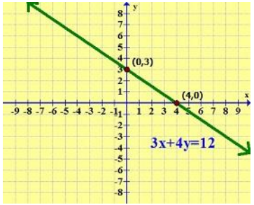
Ex: Draw the graph of the equation 3x + 4y = 12.
Now we can find some solution by the table
x | 0 | 4
y | 3 | 0

Slide 16
Solutions of Linear equation in 2 variables on a graph
A linear equation ax+by+c=0 is represented graphically as a straight line.
Every point on the line is a solution for the linear equation.
Every solution of the linear equation is a point on the line.
Any point, which does not lie on the line, is not a solution of Equation.
Certain linear equations exist such that their solution is (0,0). Such equations when represented graphically pass through the origin.
The coordinate axes x-axis and y-axis can be represented as y=0 and x=0 respectively.

Slide 17
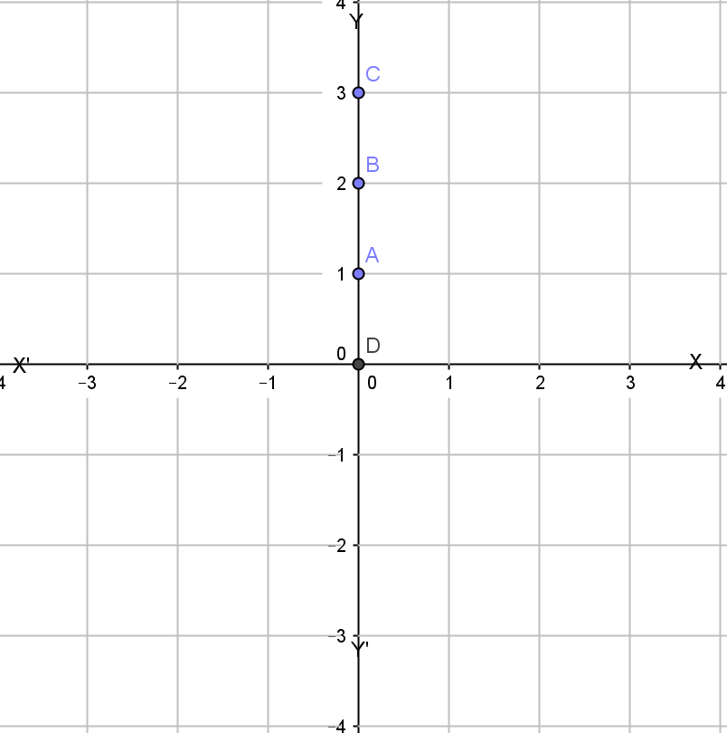
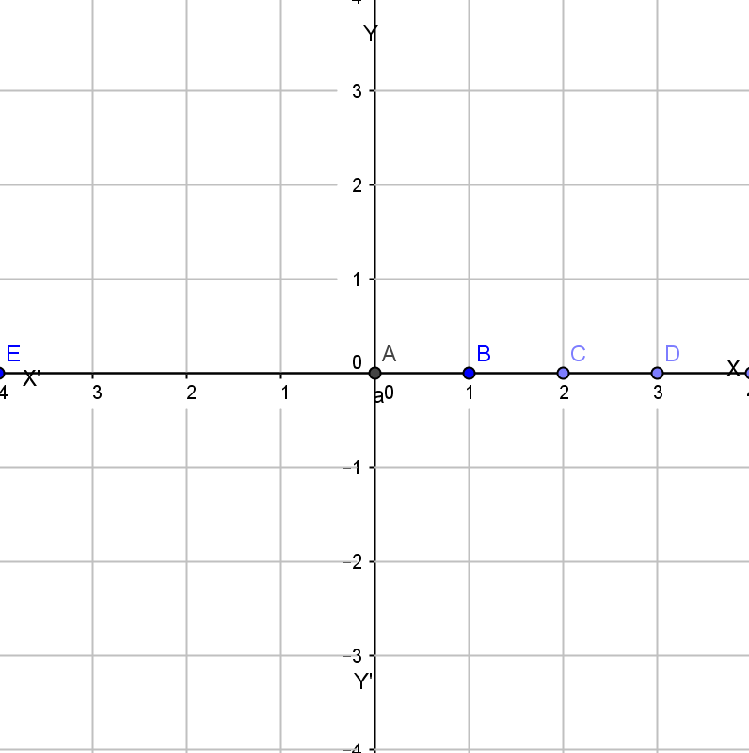
EQUATION OF X-AXIS AND Y-AXIS
The equation of y-axis is represented as x=0
When x=0 at that place it is independent of y which
indicates that we have the solution coordinates
(0,y) like: (0,1), (0,2) ,(0,3) etc.
Plotting those points on the graph and joining the
line we find it is nothing but y-axis itself.
The equation of x-axis is represented as y=0
When y=0 at that place the equation is independent
of x which indicates that we have the solution
coordinates (x,0) like (0,1),(0,2),(0,3) etc.
Plotting those points on the graph and joining the
line we find it is the x- axis itself.

Slide 18
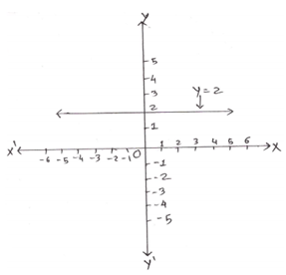
Equations of Lines Parallel to the i) x-axis and ii) y-axis
The graph of the equation y=a is a straight line parallel to x-axis. For Example: For a line that is parallel to the x-axis, the equation for such a line y=2 is given below:

Slide 19
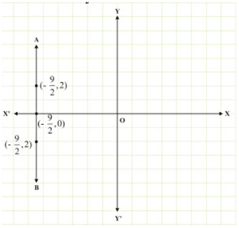
The graph of the linear equation x=a is a straight line parallel to
y-axis.For Example: The equation for such a line x=−9/2 is given below:
The graph of the linear equation x=a is a straight line parallel to y-axis.For Example:

Slide 20
When we draw the graph of the linear equation in one variable then it will be a point on the number line. x - 5 = 0
i.e x = 5
This shows that it has only one solution i.e. x = 5, so it is called linear equation in one variable.
But if we treat this equation as the linear equation in two variables then it will have infinitely many solutions and the graph will be a straight line.
x – 5 = 0 or x + (0) y – 5 = 0
This shows that this is the linear equation in two variables where the value of y is always zero. So the line will not touch the y-axis at any point.

Slide 21
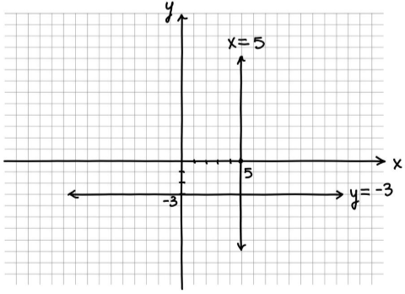
x = 5, x = number, then the graph will be the vertical
line parallel to the y-axis.
All the points on the line will be the solution
of the given equation.
Similarly if y =- 3, y = number then the graph will
be the horizontal line parallel to the x-axis.

Slide 22
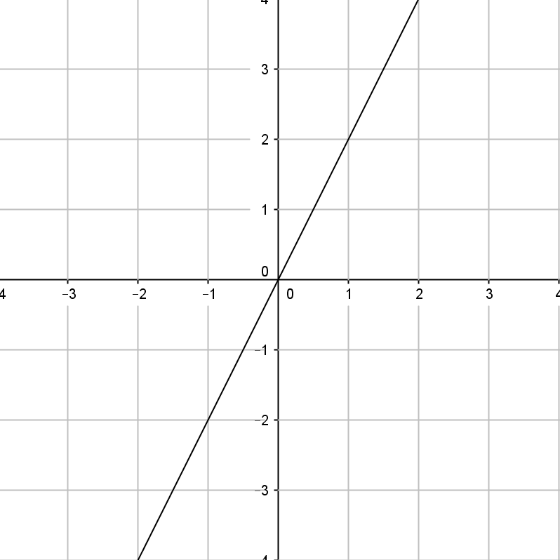
The graph of the Linear equation of the form y=kx, is a line which always passes through the origin.
Suppose if we will consider an example let y= 2x,
When we put the value x=0 in the table we find y is also equals to 0 which indicates that (0,0) is a solution of the equation. As every solution point lies on the equation line so graph of the equation will pass through the origin.

Slide 23
Practice worksheet-3
Very Short Answer Type Questions
1-What are the coordinates of the point of intersection of lines x=-1 and y=3 ?
2- Does the graph of the equation y=-3 meet x-axis ? Justify.
3- Does the point (1,2) lie on graph of 2x-3y+4=0 ? Justify.
4- Does the point (1,-2) lie on the graph of 2x+3y+4=0 ? Justify.
5- Write the point of intersection of lines x=3 and y=4 ?
Short Answer Type Question-I
1-Express y in terms of x for the equation 3x-4y+7=0.Check whether the point (23,4) and (0,7/4) lie on the graph of this equation or not?
2-Find the value of m, if (5,8) is a solution of the equation 11x-2y=3m, then find one more solution of this equation.
3- What is the number of solutions of the equation ax+by+c=0, where a²+b²not equal 0 ?
4- Can the graph of ax+by+c =0 be a curve other than straight line ?
5- For what value of k, does the point ( -1,2) lies on the graph of linear equation 4x+ky=6 ?

Slide 24
Conversion of Situations or Statements in to Linear equations Application of Linear Equation in One variable or Two variables is to use it to solve Real life situation problems taking algebraically.
So in such situations we convert the statement of the situation in to linear equations of one /two /more variables and using the known methods of solution ,we find the solution to it.
When the situation is expressed as a linear equation in one variable , we get a fixed solution to it.
When the situation is expressed as a linear equation in two variables , we get infinitely many solutions to it.

Slide 25
Example:
In countries like USA and CANADA, temperature is measured in Fahrenheit, where as in countries like INDIA, it is measured in Celsius. If it is give that the reading in Fahrenheit scale is 32 more than 9/5 of the Celsius value. Then find the situation in an equation form and draw the graph of this equation.
Also find the temperature in Fahrenheit when it is 30degree Celsius.

Slide 26
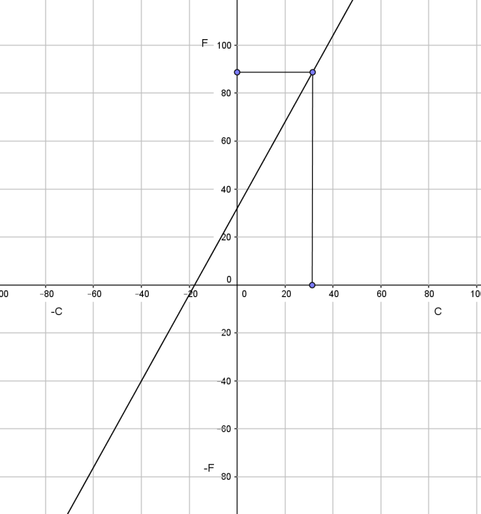
Solution : The statement can be written
in form of equation as F= ($\frac{9}{5}$) C+32
From the graph the temp in Fahrenheit is
86degree ,when temperature is 30degree
In Celsius.
C | 20 | 40
F | 68 | 104

Slide 27
Practice worksheet-4
1-A fraction becomes ¼ when 2 is subtracted from the numerator and 3 is added to the denominator. Represent this situation as a linear equation in two variables. Also find two solutions for this.
2-Sum of two numbers is 8. Write this in the form of a linear equation in two variables. Also draw the line given by this equation. Find graphically the numbers if the difference between them is 2.
3- Plot the graph of the following linear equation 2(x+3)-3(y+1)=0
Also answer the following questions:
Write the quadrant in which the line segment intercepted between the axis lie
Shade the triangular region formed by the line and the axes.
Write the vertices of the triangle so formed.
4-For what value of c, the linear equation 2x+cy=8 has equal values of x and y for its solution.
5-For the first kilometre, the fare is Rs. 5 and for successive distance it is Rs.2/Km. Taking distance covered as x and total fare as Rs.y, write a linear equation.
6- The cost of petrol in city is Rs 50/l. Write an equation with x as number of litres and y total cost.
7-Write the co-ordinates of any two points which lie on the line -x+y= -7. How many such points exists.
8-Draw the graph of the equation 2x+3y=6. From the graph, find the value of y, when x=4.

Slide 28
Summarize the Chapter:
An equation of the form ax+by+c=0, where a,b,c are Real Numbers, such that a and b both not zero, is called a linear equation in two variables.
A linear equation in two variable has infinitely many solutions
The geometrical presentation of a linear equation is a point on the real Number line , when the geometrical presentation of a linear equation in two variables is a straight line.
x=0 is the equation of y- axis and y=0 is the equation of x-axis.
The lines which are parallel to x-axis are in the form of equation as y=c, where c is a constant.
The lines which are parallel to y-axis are in the form of equation as x=c, where c is a constant.
An equation of the type y=mx is representing a line always passing through the origin.
Every point on the graph of a polynomial is a solution to the equation and every solution of an linear equation in two variables is lying on the graph of it.
Many real life situations can be converted in equation form and then can be presented by graph.

Slide 29
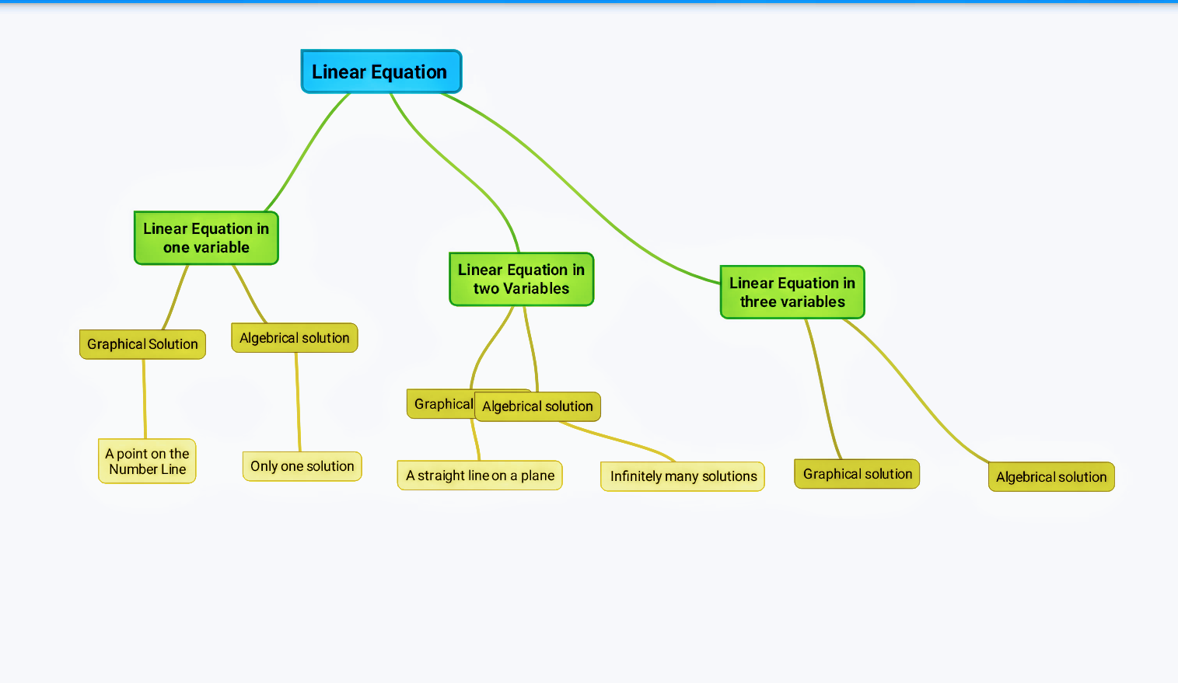
A mind map for the Topic : Linear Equation in Two variables

Slide 30
TEST WORKSHEETS ON THE CHAPTER LINEAR EQUATION IN TWO VARIABLES.
BASIC
STANDARD
ADVANCE
HOTS

Slide 31
THANK YOU

